Slide 1
Computer Organization & Assembly Language (CSC-236)
Lecture 18

Slide 2
5.5. PARAMETER PASSING THROUGH STACK
Register Limitations
Only 7 general-purpose registers are available
Subroutines + nested calls can clash on register use
Registers are fast, but not scalable
Stack: A Better Alternative
Parameters stay in memory across function calls
Stack automatically stores:
Return Address (via CALL)
Parameters (pushed before CALL)
Problem
First thing on top of stack = return address
Can’t pop parameters without messing up return flow

Slide 3
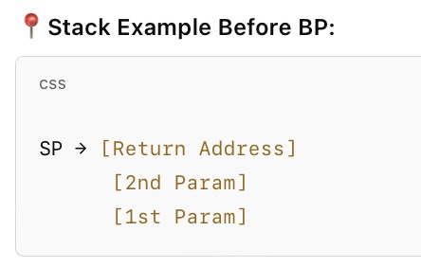
5.5. PARAMETER PASSING THROUGH STACK
Solution – Accessing Stack Parameters Safely
Problem with POP:
To get parameters:
Must POP return address first
Then POP parameters
Then PUSH return address back
Too messy, error-prone
Elegant Fix: Use BP (Base Pointer)
BP can peek into the stack without modifying it
SP can’t be used in effective address — it’s unstable
BP = safe, reliable, snapshot of current stack frame

Slide 4
5.5. PARAMETER PASSING THROUGH STACK
Advantages
Can safely read parameters at fixed offsets
Nesting safe (old BP is preserved)
Common standard in all structured assembly subroutines

Slide 5
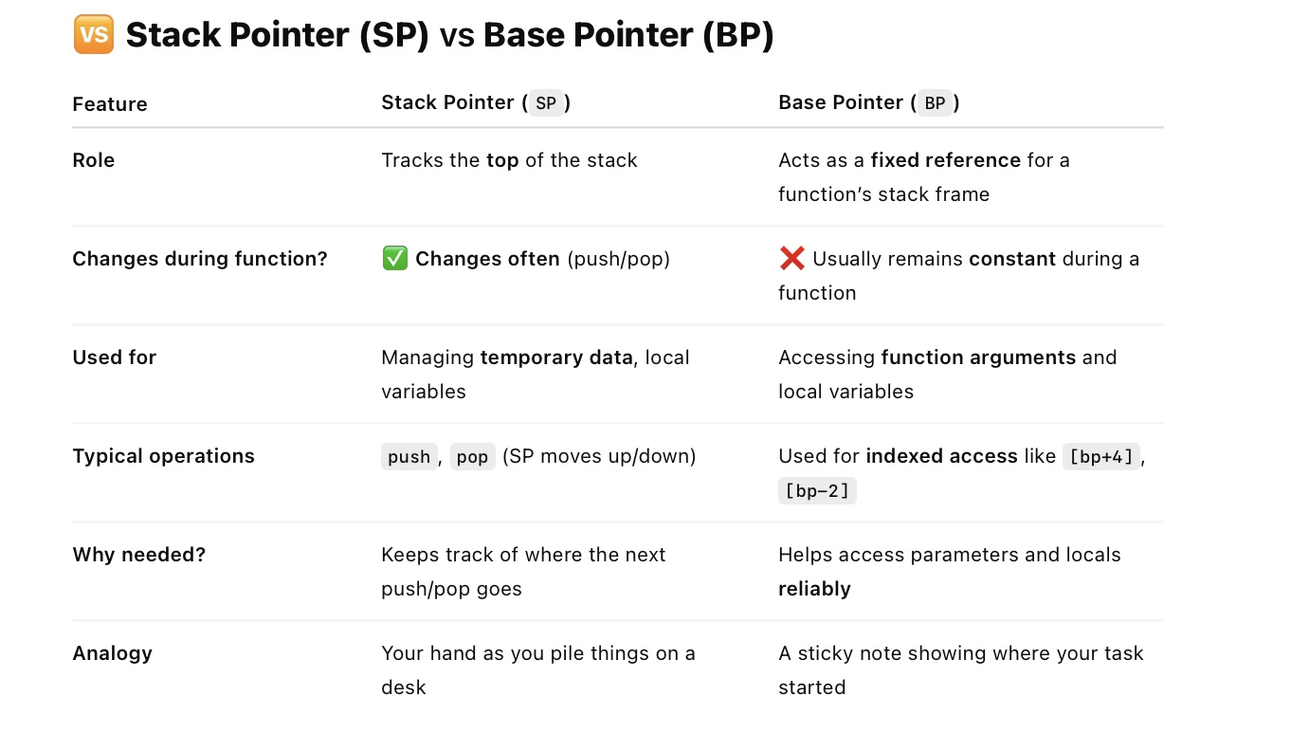

Slide 6
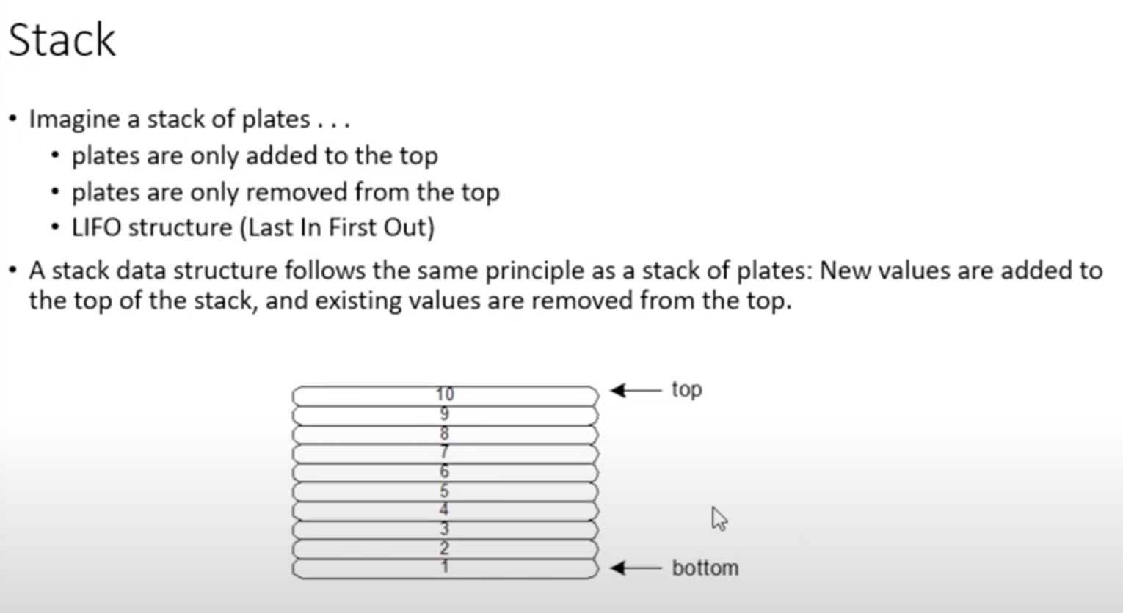

Slide 7
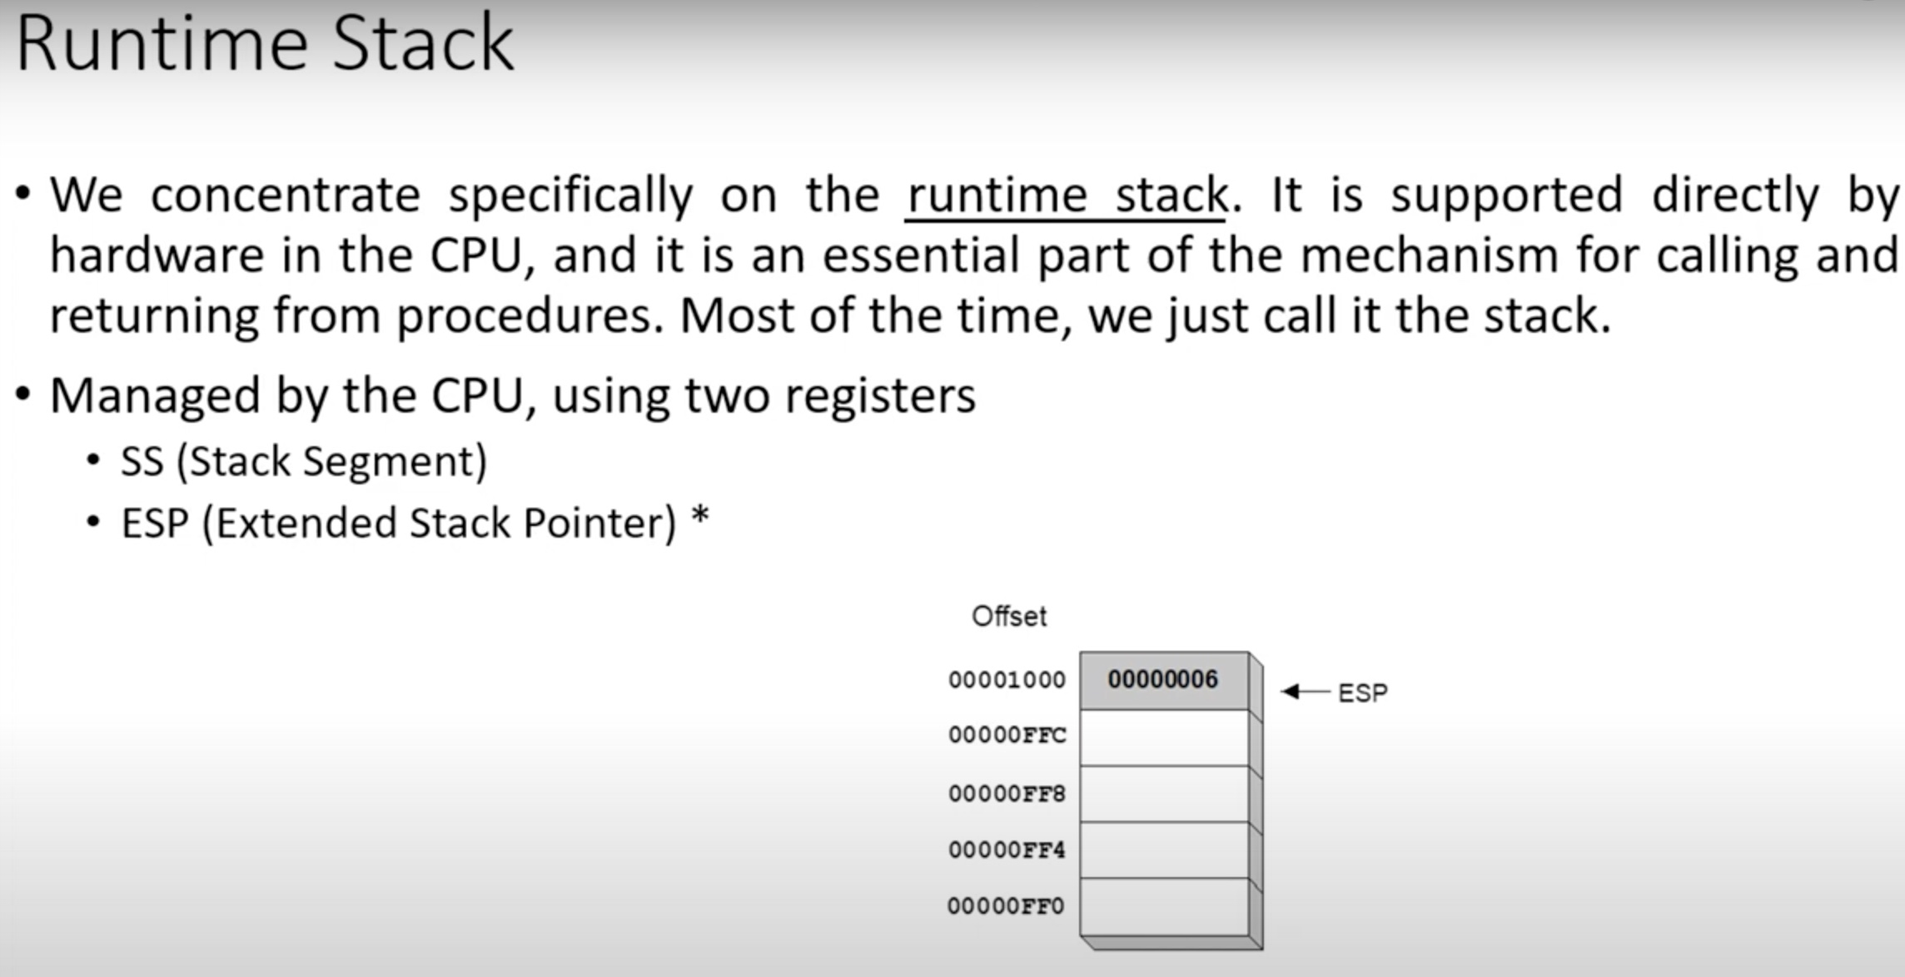

Slide 8
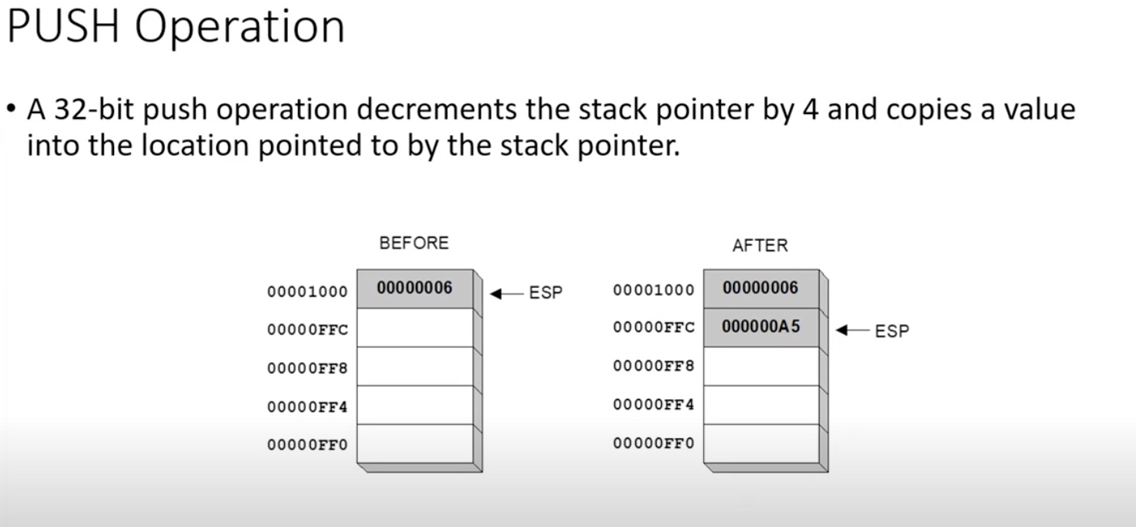

Slide 9
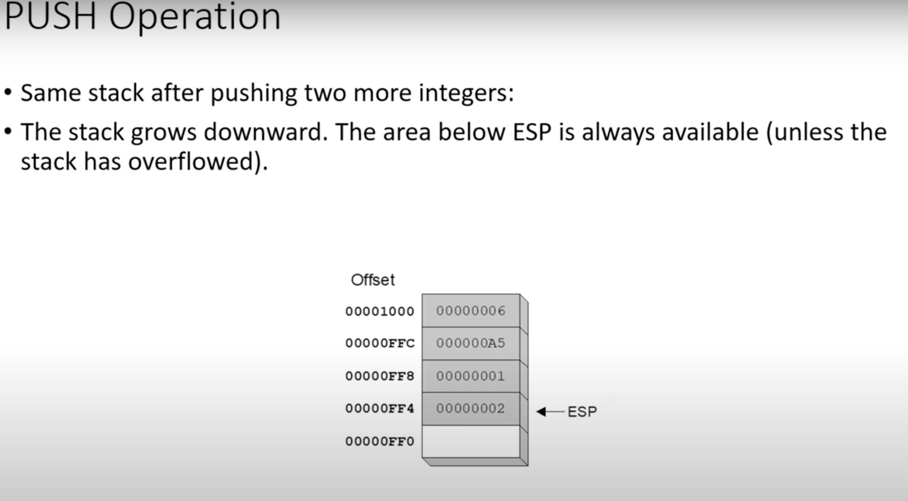

Slide 10
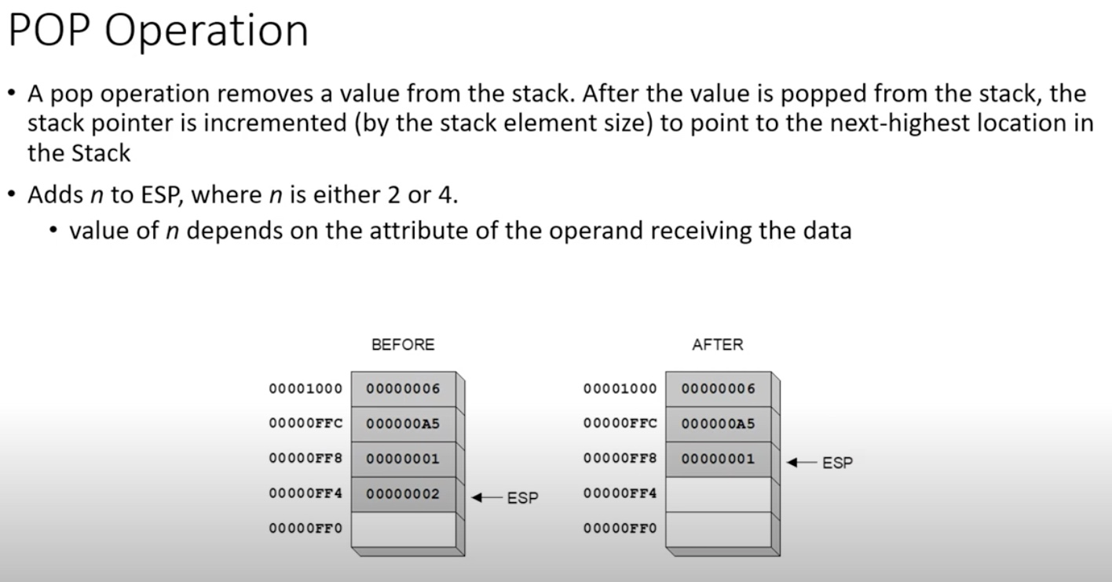

Slide 11
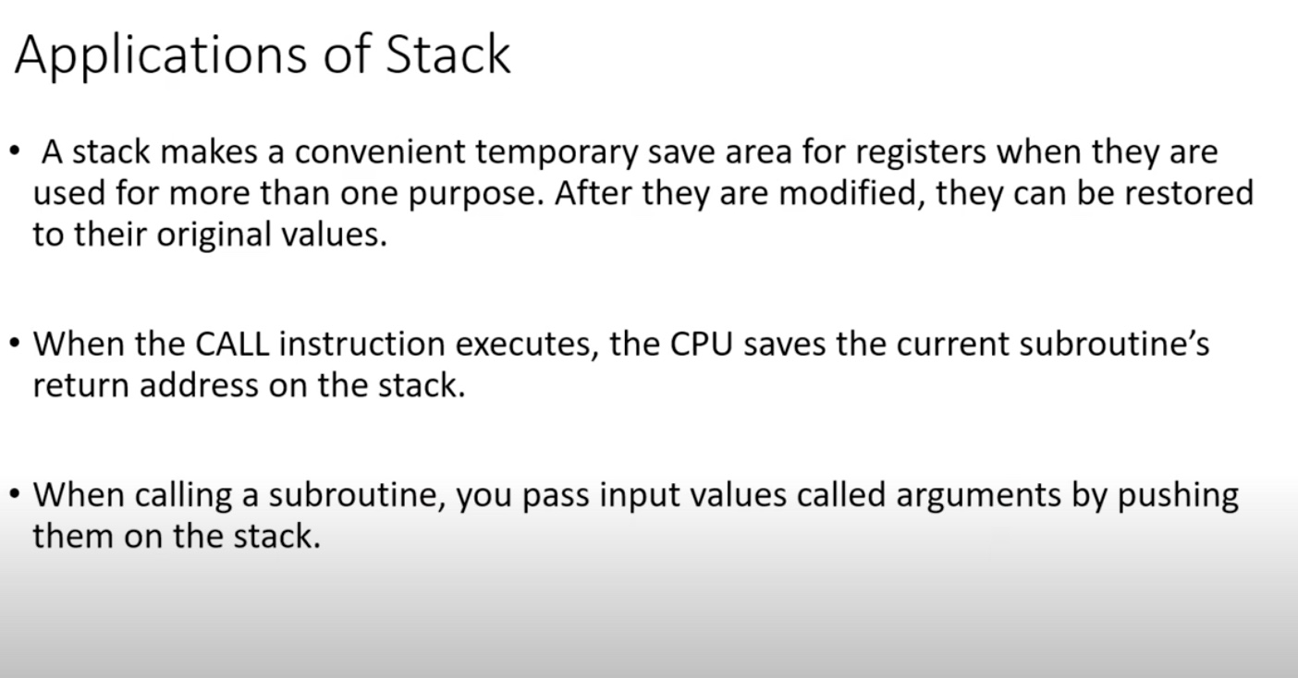

Slide 12
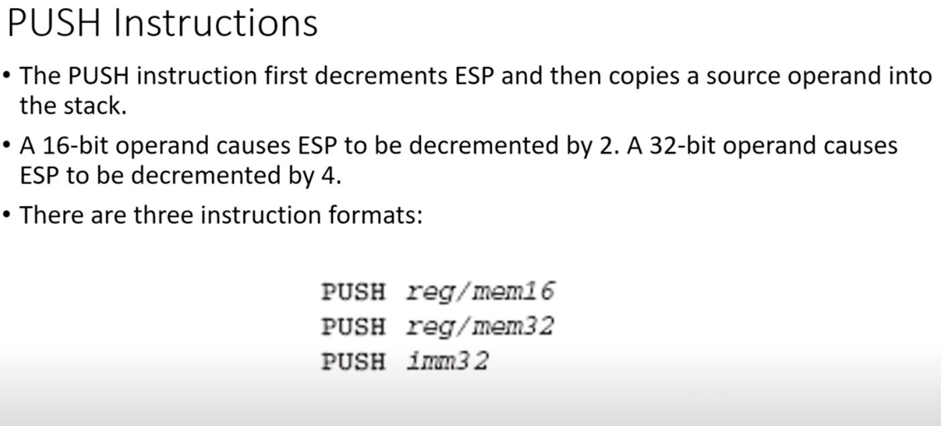

Slide 13
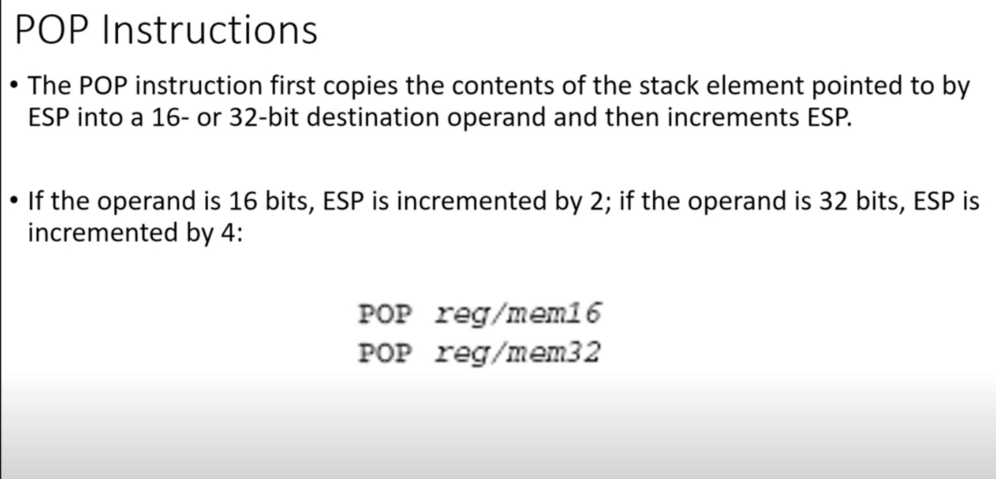

Slide 14
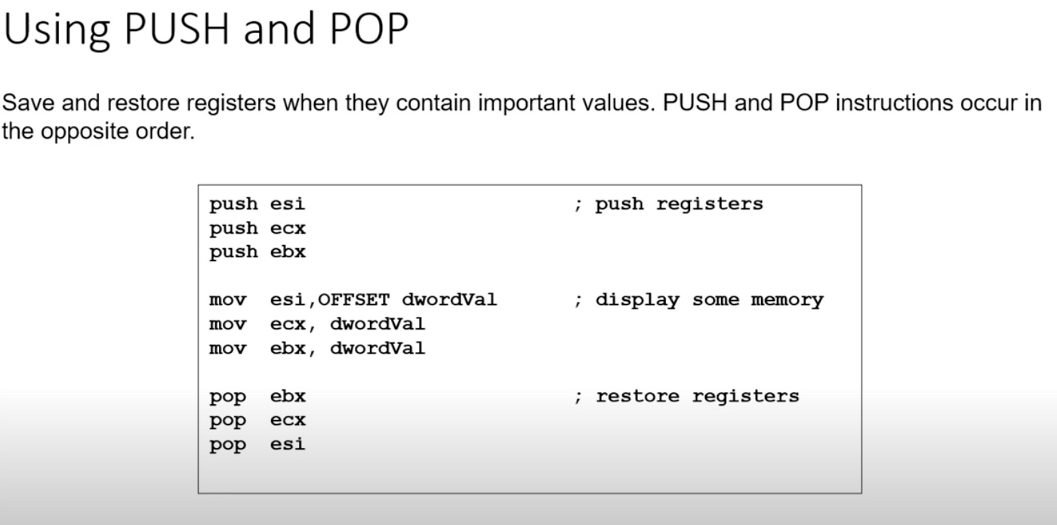

Slide 15
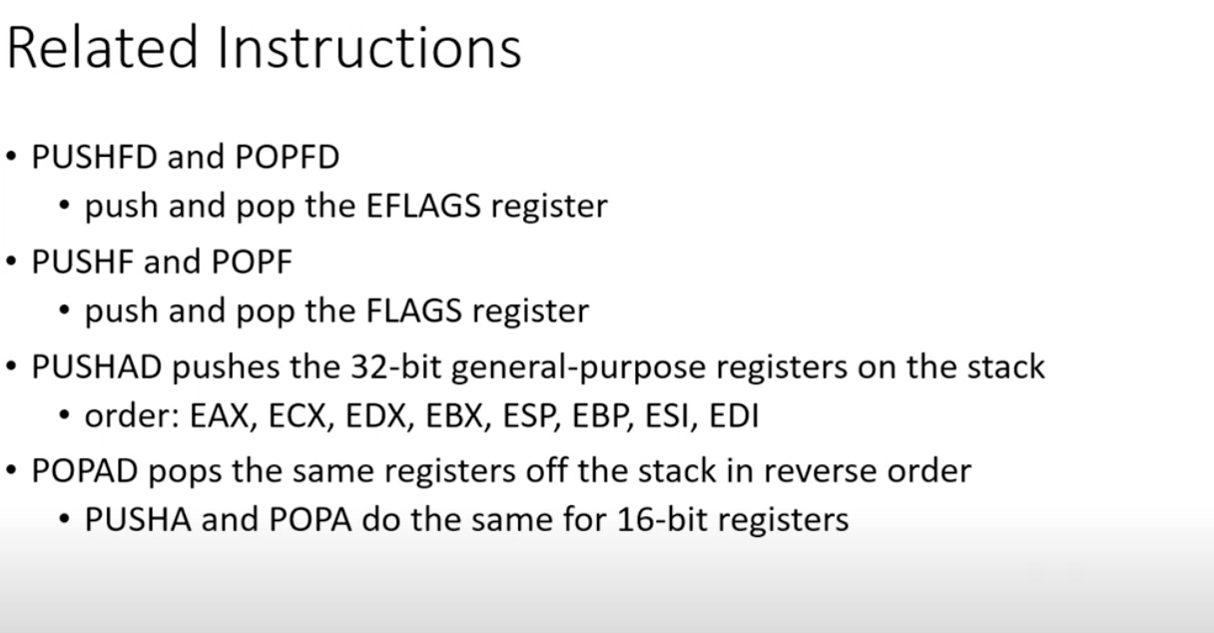

Slide 16
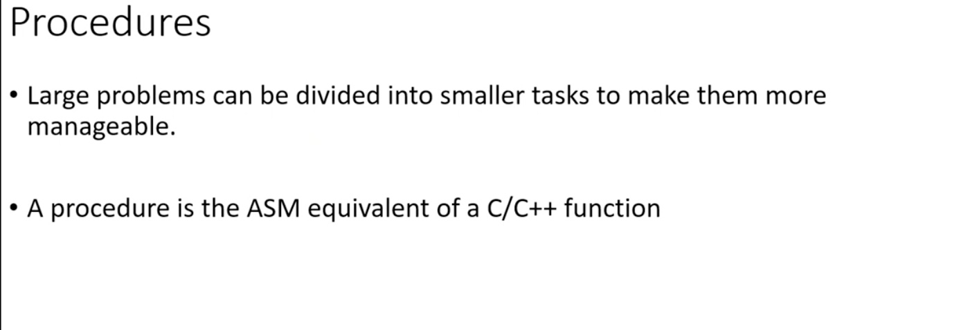

Slide 17
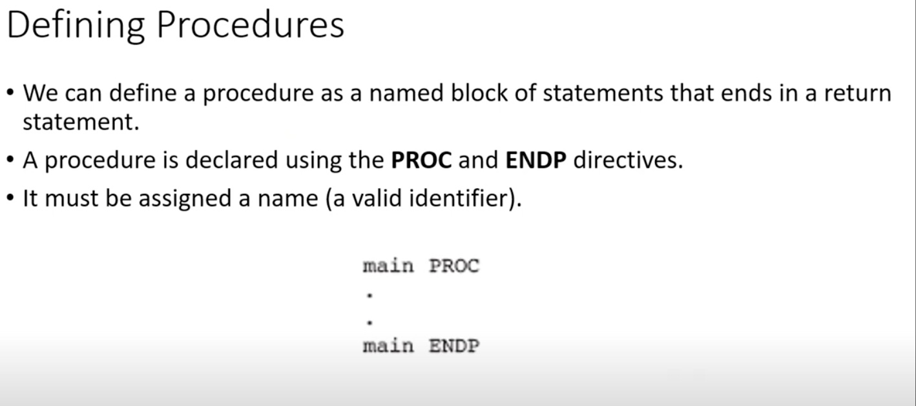

Slide 18
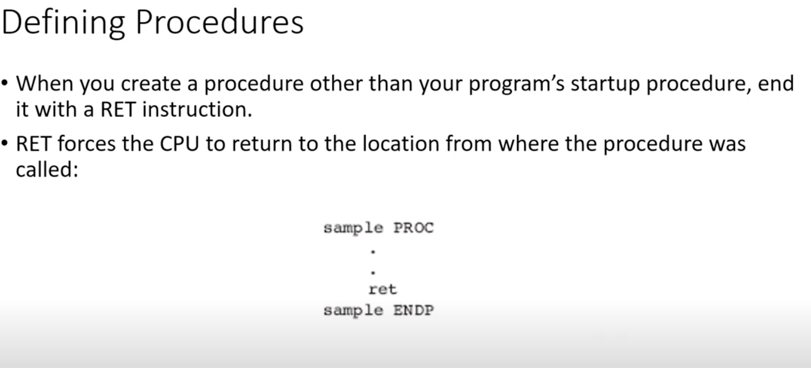

Slide 19
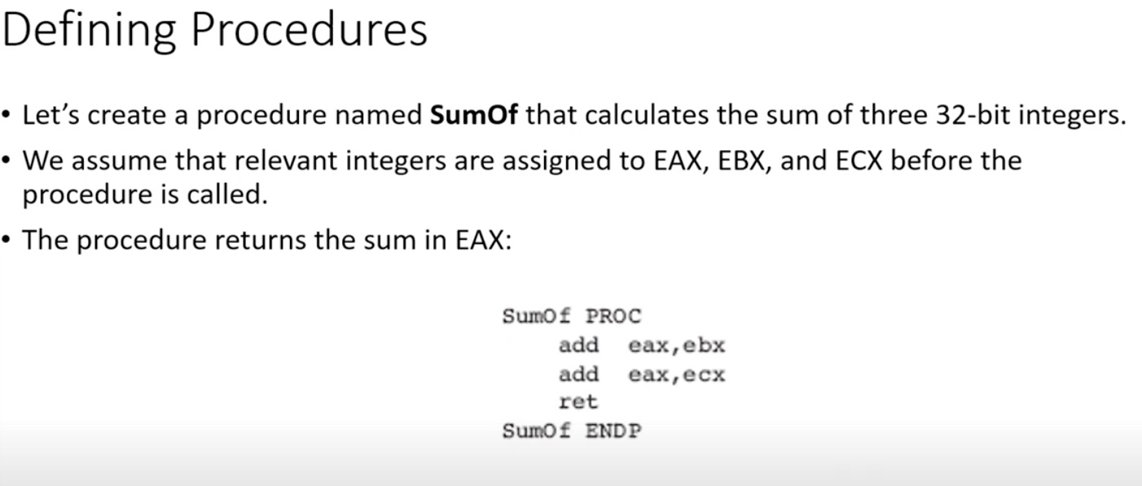

Slide 20
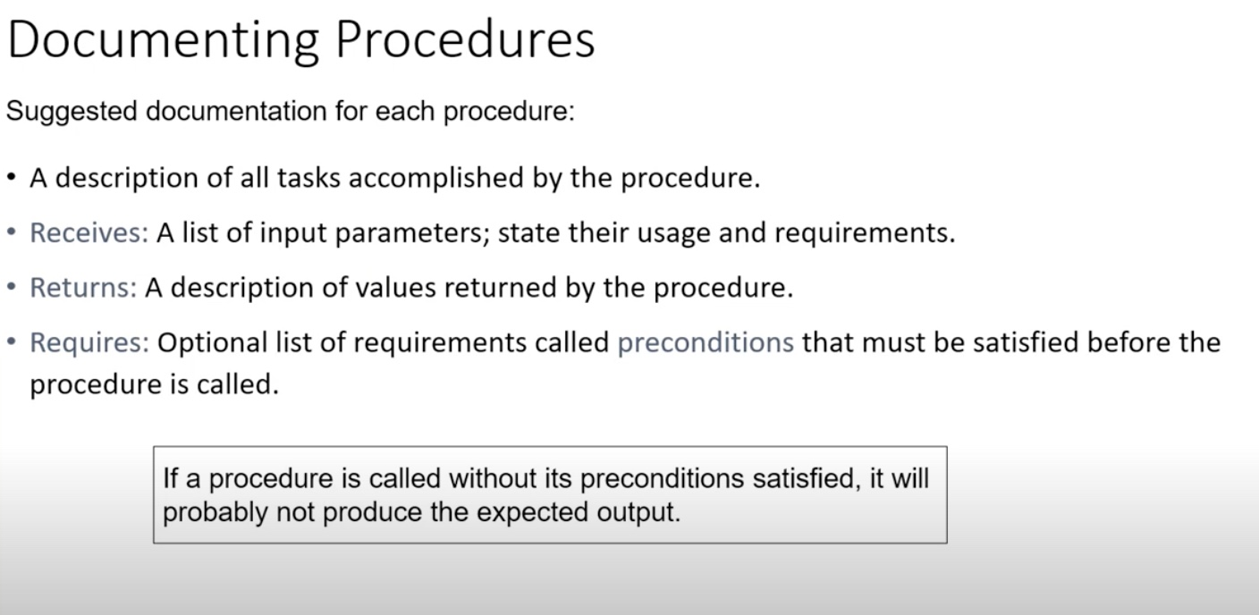

Slide 21
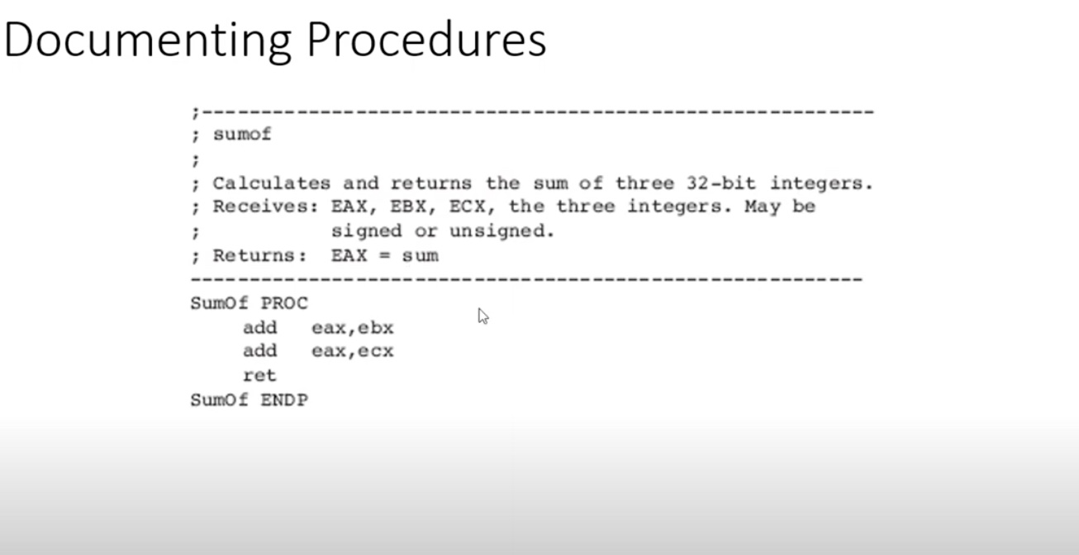

Slide 22
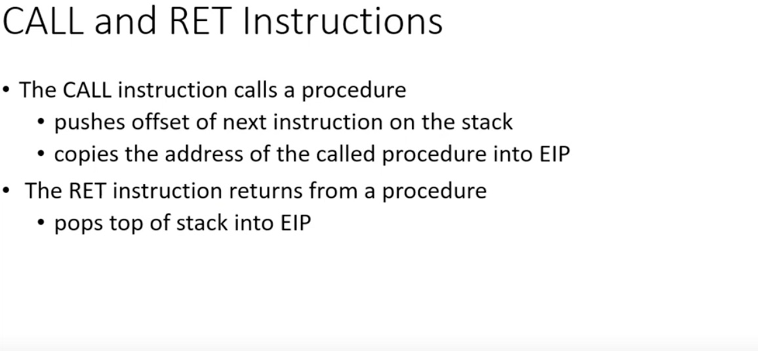

Slide 23
End of Lecture

